Slide 1




No competitor replaces a true diagnostic tool
Slide 1 · 2A + 2B
DISCREPANCIES AND ADDITIONS FROM FACT-CHECKING
11 COMPETITORS
Our list
From AI
AI missed
Visibly
CORRECTED
EyeQue
CORRECTED
CLINICAL & IN-PERSON
Can’t replace a comprehensive exam or diagnose disease such as glaucoma — routine prescription renewals only.
Needs optical hardware mounted on the phone — more cost and friction than pure software or telehealth.
Comprehensive eye exam
Snellen chart
Spot Vision Screener
Peek Acuity
CORRECTED
Spot Vision Screener
AI MISSED
AT-HOME & DIGITAL
Strictly a screening and referral tool: not diagnostic, and it can’t issue prescriptions.
Screens for amblyopia, myopia, and astigmatism risk, but needs costly hardware and trained staff; no consumer access.
Visibly
EyeQue
Peek Acuity
WHOeyes
INSTITUTIONAL SCREENING
HOW WELL DO THEY SOLVE THE PROBLEM?
School screening programs
A point of reference
Hardware adds friction
No one personalizes
Licensing-agency tests
Each platform’s results are a reference point, not something more meaningful.
Required hardware, like EyeQue’s add-on optics, strips away convenience.
None personalizes testing with AI. Focal adds custom exams and eye-health predictions.
Employer / work qualification
Airline qualification tests
Notes:
Slide 1, from Part 2A and 2B. OUR LIST = the six competitors we listed before using any AI: Snellen chart, the traditional comprehensive eye exam, Visibly, EyeQue, Peek Acuity, and WHOeyes. FROM AI = new names the AI's list surfaced: school screening programs, licensing-agency vision tests, employer/work qualification testing, and airline vision qualification testing. AI MISSED = Spot Vision Screener, which we added during fact-checking. Fact-checks against company websites and recent news: Visibly offers an FDA-cleared digital vision test by phone or computer so eye-care professionals can remotely review results and renew prescriptions; the AI missed that it cannot replace a comprehensive clinical exam or diagnose ocular disease such as glaucoma or macular degeneration, and is limited to routine renewals for eligible patients. EyeQue sells smartphone-attached optical hardware (refractometers) and apps for at-home refractive testing; the AI omitted that the hardware adds cost and friction compared with pure software or telehealth. Peek Acuity is a mobile app for rapid acuity screening in low-resource communities and schools; the AI failed to say it is strictly a screening and referral tool that cannot issue prescriptions. Spot Vision Screener (added) is a handheld device clinics and schools use to screen for risk factors like amblyopia, myopia, and astigmatism; it requires expensive hardware and trained staff and lacks direct-to-consumer access. Summary: none of these competitors can replace a true diagnostic tool, so each platform's results are a point of reference rather than something more meaningful. Required hardware strips away convenience because users need more assets at their disposal. None offers personalized testing with AI; Focal provides personalized testing and eye-health predictions, giving users a custom examination and a personal measure of their optical health and its trajectory.

Slide 2
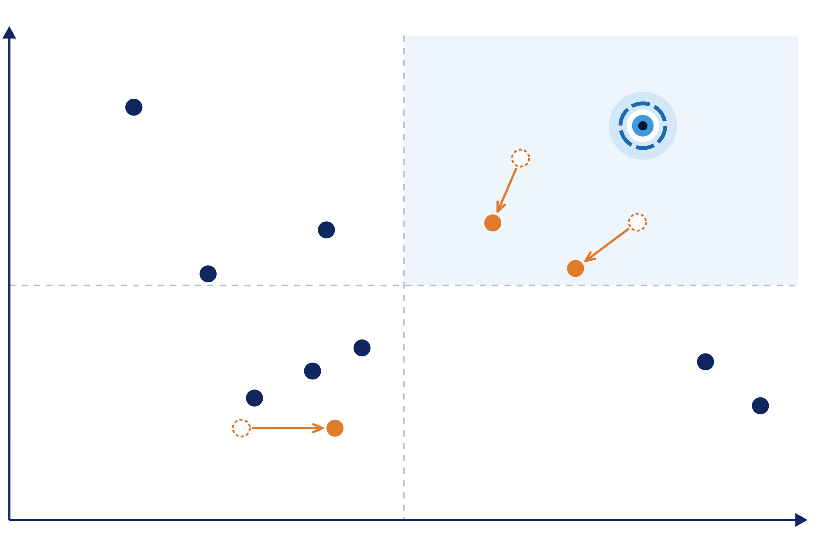




Final quadrant: the upper-right is still open
Slide 2 · 3C
Assessment capability & depth
WHAT WE CHANGED FROM THE AI
High depth · lower access
High depth · high access
EyeQue: moved down and left
Per EyeQue, no eye-health exam; FDA Class I (510(k)-exempt); users must buy phone-mounted hardware.
Comprehensive eye exam
Focal — our target
Visibly: moved left and down
FDA-cleared (2022) only for ages 22–40 and existing-prescription renewals; some states restrict online exams.
Spot Vision Screener
EyeQue
Visibly
Airline qualification
tests
Snellen chart: moved right
School screening
programs
Printed charts are cheap and widely available — no appointment or equipment. Depth stays low: acuity only.
Peek Acuity
Licensing-agency tests
Employer qualification tests
WHOeyes
Focal: added, upper-right
Snellen chart
Accessible and comprehensive, with standardized, organization-ready testing for agencies, airlines, and rentals.
Narrower · lower access
Narrower · high access
Axes kept from the AI: they match our pre-work dimensions
Accessibility & efficiency
Kept
Moved
AI’s original
Notes:
Slide 2, from Part 3C (graded version). We kept the AI's axes — Accessibility and Efficiency (x) and Assessment Capability and Depth (y) — because they match the dimensions we drafted in pre-work and reflect the convenience-versus-depth tradeoff from 3A. We kept all 10 AI-identified competitors plus Spot Vision Screener, and made three moves. EyeQue moved down and slightly left: EyeQue states its products do not include any form of eye health exam, and it is registered with the FDA as a Class I device exempt from 510(k) review rather than cleared through it; it measures only acuity and refractive error, and the phone-mounted hardware users must buy lowers accessibility. Visibly moved left and down a little: it received FDA 510(k) clearance in 2022 as the first online visual acuity test, but that clearance limits it to adults 22 to 40, it is meant for renewing existing prescriptions, and some states restrict online eye exams; we placed it below EyeQue on depth because it only offers a self-administered acuity test. The Snellen chart moved right: printed charts are inexpensive, widely available, and need no appointment or special equipment, while depth stays low because it only measures acuity. Finally, we added Focal's target position in the top right. No current competitor is both highly accessible and comprehensive — the gap Focal aims to fill through app-based, dynamic testing — and most at-home tools aren't designed for the standardized, organization-ready testing that licensing agencies, airlines, and rental companies need.

Slide 3
The AI’s SWOT: EyeQue as the leader
Slide 3 · 4A
S
Strengths
W
Weaknesses
WHERE WE CORRECTED THE AI
At-home access plus acuity testing and refractive-error estimation
More depth than basic smartphone tools like WHOeyes and Peek Acuity
Self-administered — avoids clinic visits for routine checks
Phone-mounted optical hardware adds cost and setup friction
Less comprehensive than an in-person exam; no disease diagnosis
Weaker evidence of institutional or regulatory acceptance
1
Different leader
We ran our own SWOT on Visibly instead of EyeQue.
2
FDA clearance isn’t an umbrella
Visibly’s clearance covers only adults 22–40 — the range where eye problems are least common. Less groundbreaking than it sounds.
O
Opportunities
T
Threats
Add vision measures beyond acuity and refractive error
Stronger longitudinal tracking for early detection of change
Standardized workflows for organizations that repeat screening
Visibly: remote convenience plus clinician review and stronger regulatory credibility (corrected →)
Comprehensive eye exams remain the reference for breadth
Spot and institutional programs where hardware and control matter
3
Optometry pushback, unmentioned
The AI never flagged the opposition Visibly and EyeQue face from optometry specialists and lobbyists.
Notes:
Slide 3, from Part 4A — the AI-generated SWOT (unedited content, condensed for the slide). The AI chose EyeQue as the leader. Strengths: combines at-home access with acuity testing and refractive-error estimation; more depth than WHOeyes and Peek Acuity; self-administered testing addresses unnecessary clinic visits. Weaknesses: specialized phone-mounted hardware adds cost and setup friction; less comprehensive than an in-person exam and doesn't solve the disease-diagnosis gap; less evidence of institutional or regulatory acceptance than Visibly or traditional qualification testing. Opportunities: broader measures beyond acuity and refractive error; stronger longitudinal tracking; standardized workflows for organizations. Threats: Visibly can compete on remote convenience with clinician review and stronger regulatory credibility; comprehensive exams remain the reference; Spot and institutional programs may be preferred where organizations value dedicated hardware and controlled workflows. AI's view: EyeQue reduces access friction without collapsing to acuity alone, but its depth comes from added hardware rather than a fully software-based, institution-ready workflow. Our corrections (4B): we chose Visibly for our own SWOT; FDA approval is not an all-encompassing umbrella — Visibly's clearance is limited to ages 22 to 40, a sweet spot where eye-related issues are least common, so it is less groundbreaking than total clearance; and the AI did not mention the pushback services like Visibly and EyeQue are getting from optometry specialists around the country.

Slide 4
Our SWOT of Visibly: strengths and weaknesses
Slide 4 · 4B
S
Strengths
W
Weaknesses
How well Visibly solves the problem
Where Visibly falls short
Remote and convenient
Mainly acuity and prescription renewal — limited test scope
FDA-cleared acuity test
Needs clinician review
Nationwide network of licensed eye-care providers
FDA-cleared only for adults aged 22–40
AI MISSED
The age range where eye problems are least common, so the clearance is less groundbreaking than full coverage.
At-home conditions vary from test to test
Relies on retail and licensed-provider partners
Selected competitor: Visibly. The AI’s SWOT (Slide 3) used EyeQue.
Notes:
Slide 4, from Part 4B — our own SWOT (no AI for the judgments), competitor: Visibly, a different pick from the AI's leader (EyeQue). Strengths: remote and convenient; an FDA-cleared acuity test; a nationwide network of licensed eye-care providers. Weaknesses: test scope limited mainly to acuity and prescription renewal; needs clinician review; intended for adults and FDA-cleared only for the 22 to 40 age range; at-home conditions may differ from test to test; reliant on retail and licensed-provider partners. Where we corrected the AI: FDA approval is not an all-encompassing umbrella. The clearance Visibly or any current solution has is limited to ages 22 to 40, a sweet spot where eye-related issues are least common, so it is less groundbreaking and impressive than total clearance coverage.

Slide 5
Our SWOT of Visibly: opportunities and threats
Slide 5 · 4B
O
Opportunities
T
Threats
Where the problem remains unsolved
What could stand in the way
Broader vision testing
Visibly expands into broader vision testing
Tracking over time
Large eye-care companies build similar digital tools
Regulated screening
Clinics or regulators don’t trust remote results
Partnerships with retailers, contact-lens sellers, employers, and insurers
Privacy or cybersecurity issues with stored health data
Opposition from optometry specialists and lobbyists (“BigOpto”)
In-store testing that doesn’t require professional staff
AI MISSED
The AI never mentioned the pushback Visibly and EyeQue face from optometry specialists across the country.
Notes:
Slide 5, from Part 4B — our own SWOT of Visibly, continued: the strategic direction. Opportunities (where the problem remains unsolved): broader vision testing; tracking over time; regulated screening; partnerships with retailers, contact-lens sellers, employers, and insurers; expansion of in-store testing that does not require professional staff. Threats: Visibly expands into broader vision testing; large eye-care companies build similar digital tools; clinics or regulators do not trust remote results; privacy or cybersecurity issues with stored sensitive healthcare data; opposition from optometry specialists and lobbyists (BigOpto). Where we corrected the AI: the AI did not mention any of the pushback services like Visibly and EyeQue are getting from optometry specialists around the country.

Slide 6


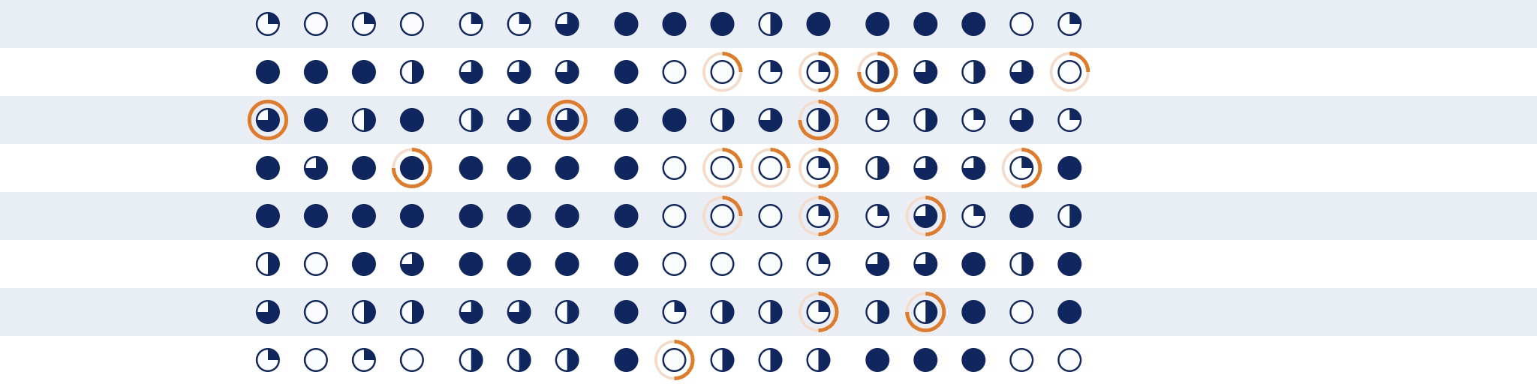
Harvey balls: 8 competitors, 17 criteria
Slide 6 · 5C
Access & Service
Delivery
Cost & Time
(new)
Assessment &
Monitoring
Institutional &
Market Fit
Strong
None
CHANGES FROM THE AI
Orange arc: the AI’s original score
Added a Cost & Time category, with new Affordability and Turnaround time criteria
Low equipment
burden
Removed licensing-agency and employer tests: testing contexts, not distinct products
Low professional
involvement
Speed /
convenience
Visual-acuity
capability
Refractive-error
capability
Broader vision
screening
Longitudinal
tracking
Comprehensive
assessment depth
Regulatory
readiness
Standardization /
test integrity
Organizational
acceptability
Direct-to-consumer
suitability
Accessibility
School / community
scalability
Remote use
Affordability
Turnaround time
Orange labels: our additions
Rescored 18 cells. Our evidence, row by row:
Comprehensive eye exam
Visibly
FDA-cleared for acuity only, ages 22–40; doesn’t screen for eye disease
EyeQue
Needs $129 hardware and provider review; doesn’t evaluate ocular health
Peek Acuity
No professional needed, but not a self-test; acuity only; no saved results
WHOeyes
Standardized and ETDRS-evaluated, but acuity only; misses peripheral defects
Snellen chart
School screening programs
Varies by jurisdiction and training; built for referral, not diagnosis
Airline vision qualification testing
FAA checks acuity thresholds; no refraction or prescription
Notes:
Slide 6, from Part 5C (graded version). Our final matrix covers 8 competitors across 17 criteria in four categories. Cost and Time is new relative to the AI's matrix: Affordability and Turnaround time come from our own starting attributes, and Speed/convenience moved there. Licensing-agency and employer/work-qualification tests were removed because they are testing contexts rather than distinct products or providers, and their procedures commonly use tools already in the matrix. No criteria were removed. Affordability and turnaround time for school-screening and airline programs vary by jurisdiction, so treat those scores as approximate. The 18 changes (AI to ours) and evidence: Visibly — broader screening ◔ to ○, depth ◐ to ◔, regulatory readiness ◕ to ◐, school scalability ◔ to ○: its FDA-cleared product assesses acuity only and does not screen for or diagnose eye disease; only VDAP is cleared and full refraction is 'coming soon'; VDAP is for adults 22 to 40 and the service needs an existing prescription (FDA 510(k) summary; Visibly). EyeQue — accessibility ● to ◕, turnaround ● to ◕, depth ◕ to ◐: VERAI needs a compatible phone and $129 proprietary hardware; the measurement takes about 15 minutes but a licensed provider must review before a prescription; it does not evaluate glaucoma, cataracts, retinal disease, or ocular health (EyeQue VERAI). Peek Acuity — low professional involvement ◕ to ●, broader screening ◔ to ○, longitudinal tracking ◔ to ○, depth ◐ to ◔, direct-to-consumer ◐ to ◔: no licensed professional needed but another person must administer it; distance acuity only; the standalone app displays but does not record results; it does not replace an eye-care professional; free but Android-only (Peek). WHOeyes — standardization ◐ to ◕, broader screening ◔ to ○, depth ◐ to ◔: a standardized tumbling-E test evaluated in three studies against ETDRS, but distance control is manual on Android; it does not detect peripheral defects; no refraction or eye-health exam (WHO). School screening — standardization ◕ to ◐, depth ◐ to ◔: programs vary by jurisdiction, equipment, and training, with false-result risks; screening identifies who needs referral and is not a diagnosis (WHO handbook). Airline qualification — refractive-error capability ◐ to ○: FAA testing checks acuity thresholds and does not perform refraction or calculate a prescription (FAA medical standards).

